Slide 1
FACE RECOGNITION USING KNN & OPENCV Final Project of MACHINE LEARNING

Slide 2
Group Member Information
TALLURI JOHN EMMANUEL RAJ (700742724)
CRN: 30460
ML: CS-5710

Slide 3
Role/Responsibilities and Contribution in project
Word Documentation
Final Increment Documentation
Coding and Test Casing
Presentation
GitHub Upload
Data Collection
Final Output Verification
John Emmanuel (700742724)

Slide 4
Motivation
Face recognition has numerous practical applications, including security systems, access control, surveillance, and personalized user experiences. The motivation behind this project is, by using this facial recognition one can gain easy access to their specified roles using their facial data rather than an input text which is not a reliable way to access a highly confidential data or role. The main motivation doing this using KNN is its simplicity, efficacy, and adaptability for classification tasks are the driving forces behind its use in face recognition. The main justifications would be KNN is a Straightforward and Natural Method, it’s Effective in High-Dimensional Spaces, Non-parametric Learning and its Resistance to Change.

Slide 5
Objectives
The main objective of this project is to develop a robust face recognition system that can accurately identify individuals in real-time using the stored face details. The algorithm uses the KNN to match the extracted features of the input face and match it with the one that has the most similar facial features in the database. The K-nearest neighbors (KNN) method is a face recognition technique that aims to create a system that can properly recognize and categorize people based on their facial attributes. Face recognition can be performed using KNN, a well-liked machine learning method for classification problems, by comparing the distances between feature vectors of known faces and an unknown face to identify the most similar faces. The important goal is to achieve high accuracy and in an efficient programming structure allowing for a domain to have a quick and reliable recognition of individuals.

Slide 6
Related work
I have used the KN-Nearest Neighbor Algorithm to generate an GUI based application that uses OpenCV to access the visual peripherals.
I have also used other modules such as pickle, os, numpy, tkinter, PIL to perform and enable various functionalities to the my algorithm
The overall main goal of the project is recognize the presence or grant authentication to an individual to the specified role by scanning the facial details of the person and storing them in the database and when tried to invoke authentication the algorithm will try to scan the face and tries find the similar data if available in the database and show the name of the person as output with a box around their face and name being displayed beside.

Slide 7
Related work
The GUI allows users to perform different actions. The "ADD NEW FACE DATA" button triggers the `add_data()` function to capture and store face data. The "NAMES IN DATABASE" button displays the stored names in the console. Finally, the "START RECOGNIZING" button checks if there is data available in the database and then initiates the face recognition process.
Overall, the algorithm has a high efficiency and accuracy and has a decent GUI to perform actions on the code without all being the console interaction

Slide 8
Problem Statement
Title: Face Recognition Using K-Nearest Neighbors Algorithm and OpenCV
Problem Statement:
The aim of this project is to develop a face recognition system using the K-Nearest Neighbors (KNN) algorithm and OpenCV library. The system should be able to accurately recognize and classify individuals based on their facial features in real-time video streams or static images. The project seeks to address the following challenges:
Face Detection, Feature Extraction, Face Classification, Real-time Performance, Accuracy, Robustness User Interface
By addressing these challenges, the project aims to create a robust and efficient face recognition system using the KNN algorithm and OpenCV, with potential applications in security, access control, surveillance, and human-computer interaction.

Slide 9
Proposed Solution
The project implementation involves several steps. At first, we import all the required libraries such as OpenCV, NumPy, Pickle and KN-Neighbor classifier from scikit library. The face data is then used to train a KNN classifier, where each face is represented by a feature vector and it accumulates the vectorized values for the comparison. During the recognition phase, the system captures video frames, detects faces using a Haar cascade classifier, extracts feature from the detected faces, and matches them against the features in the trained KNN model. The recognized individuals are displayed on the video capture box, along with bounding boxes around their faces and their names displayed. This identification can be used for several purposes and one of which is gathering large attendance in any domain in mere seconds which could save potential time and effort, thus leaving more time for important activities. The interpreter used is PyCharm as I wanted to store the modules in my personal computer rather than having them online if I went with Google Collab

Slide 10
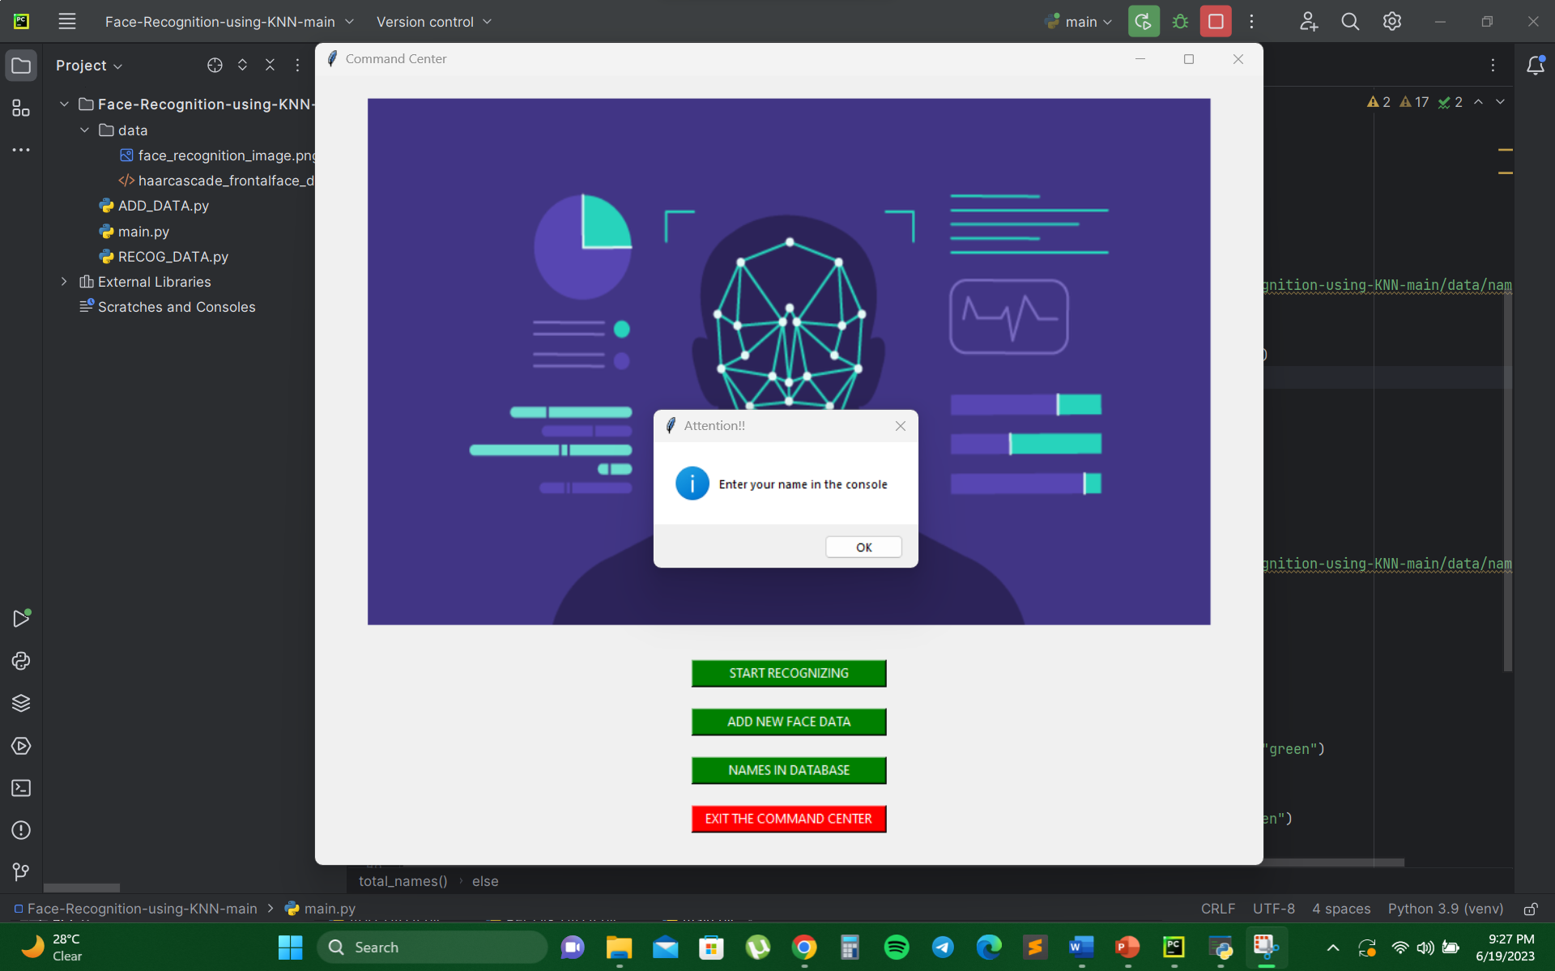
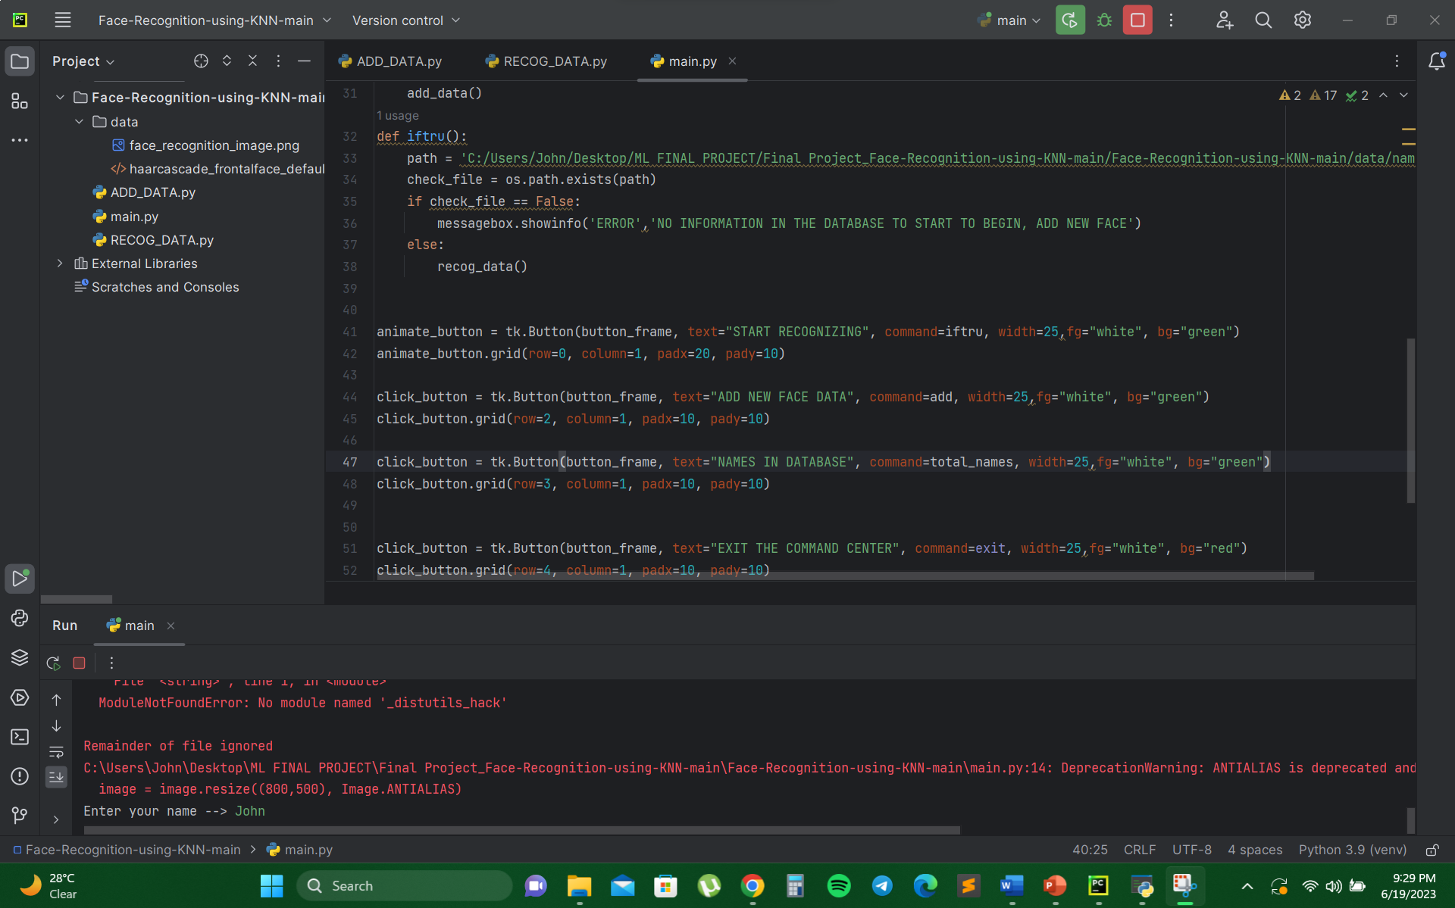
Results/Simulations
ADDING FACES:

Slide 11
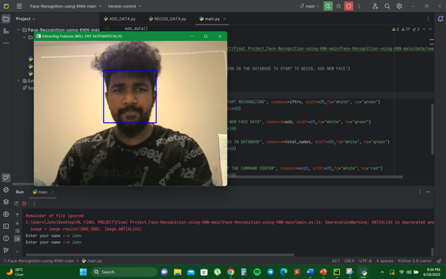
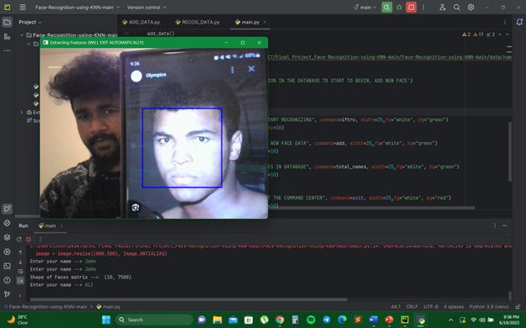
Results/Simulations
ADDING FACES:

Slide 12
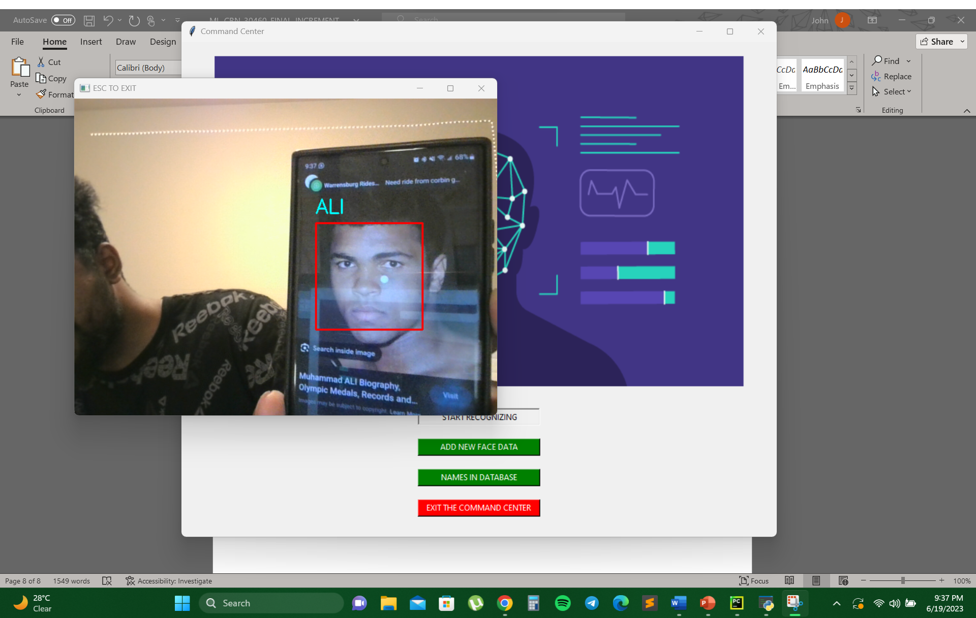
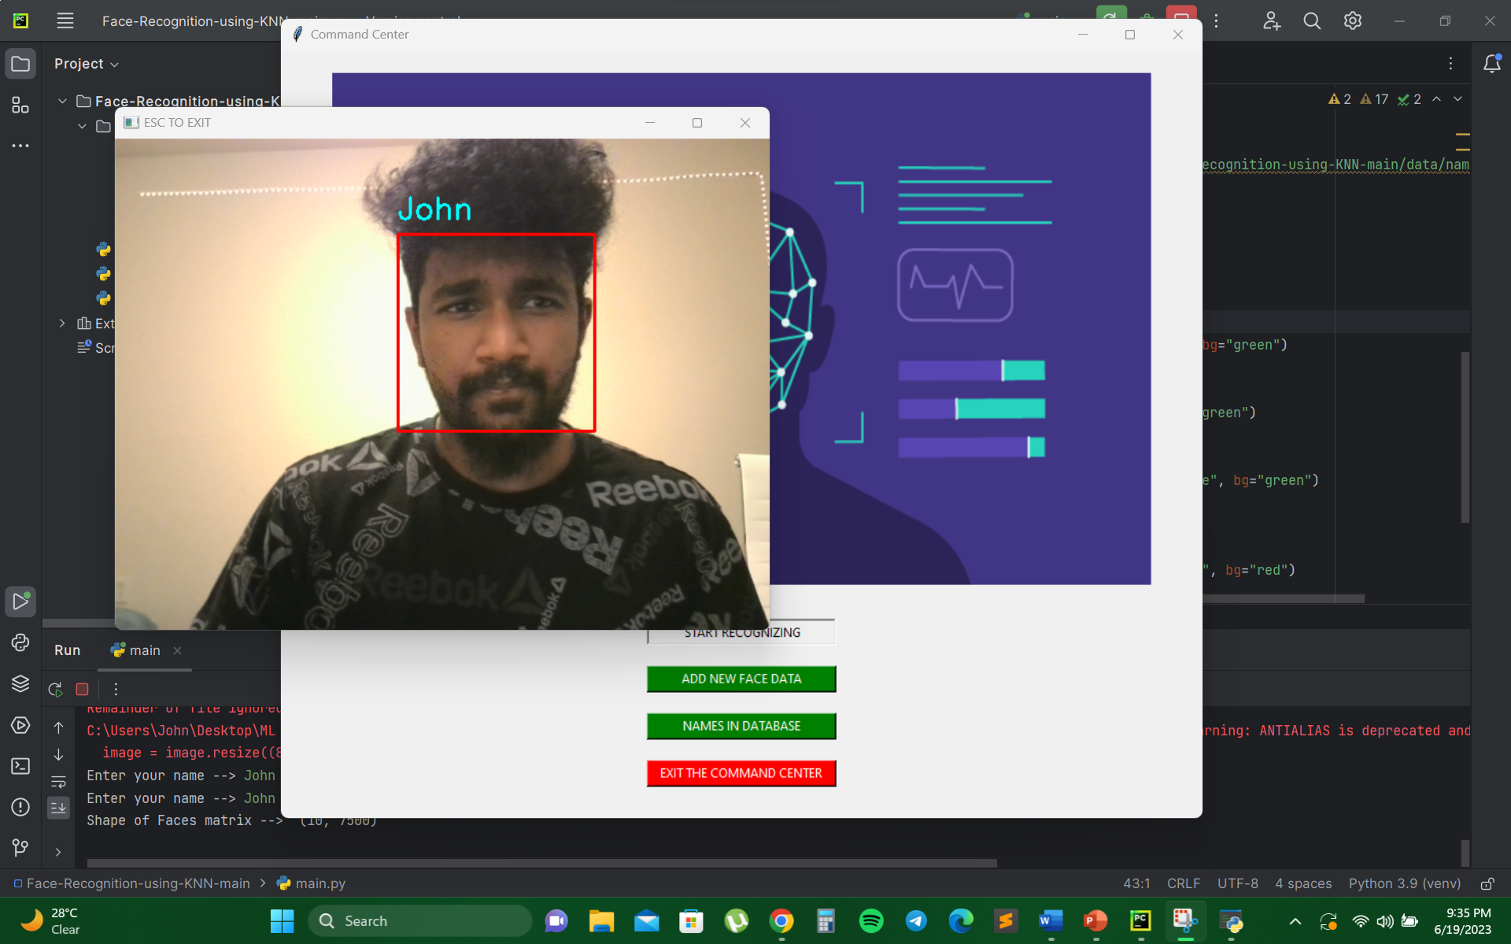
Results/Simulations
RECOGNIZING:

Slide 13
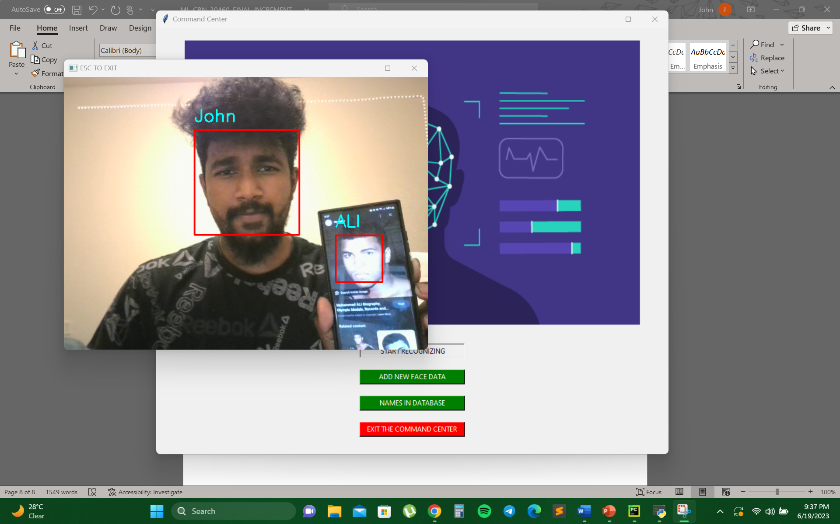
Results/Simulations
RECOGNIZING:

Slide 14

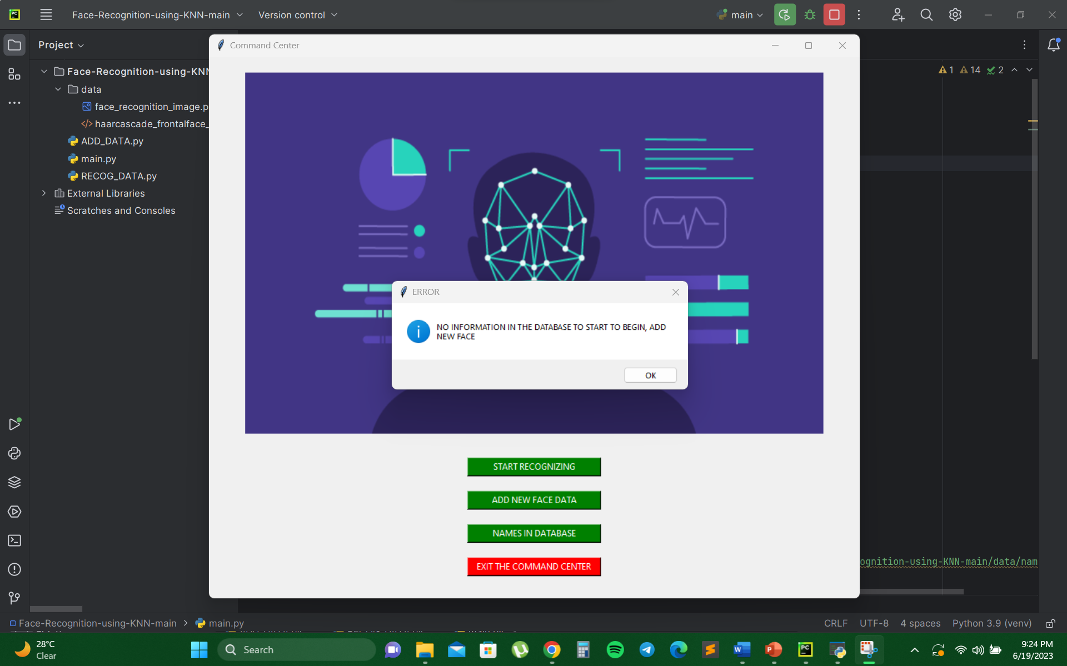
Results/Simulations
GUI &EXCEPTION HANDLING:

Slide 15
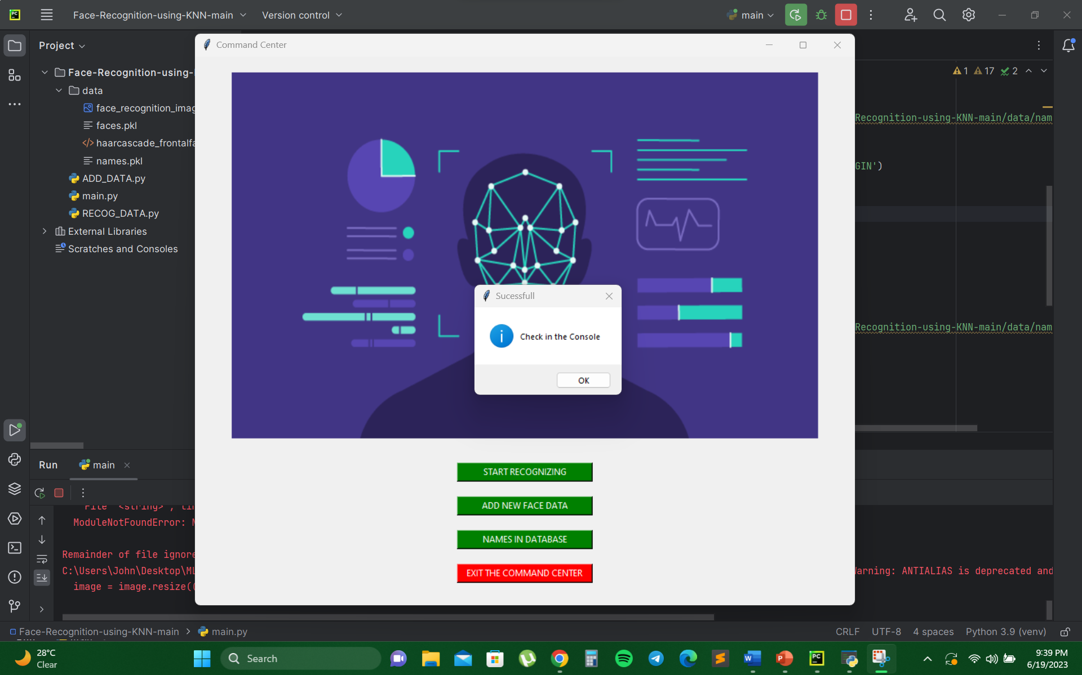
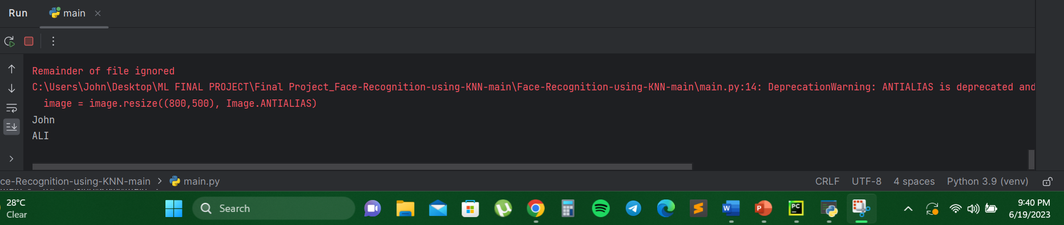
Results/Simulations
GUI &EXCEPTION HANDLING:

Slide 16
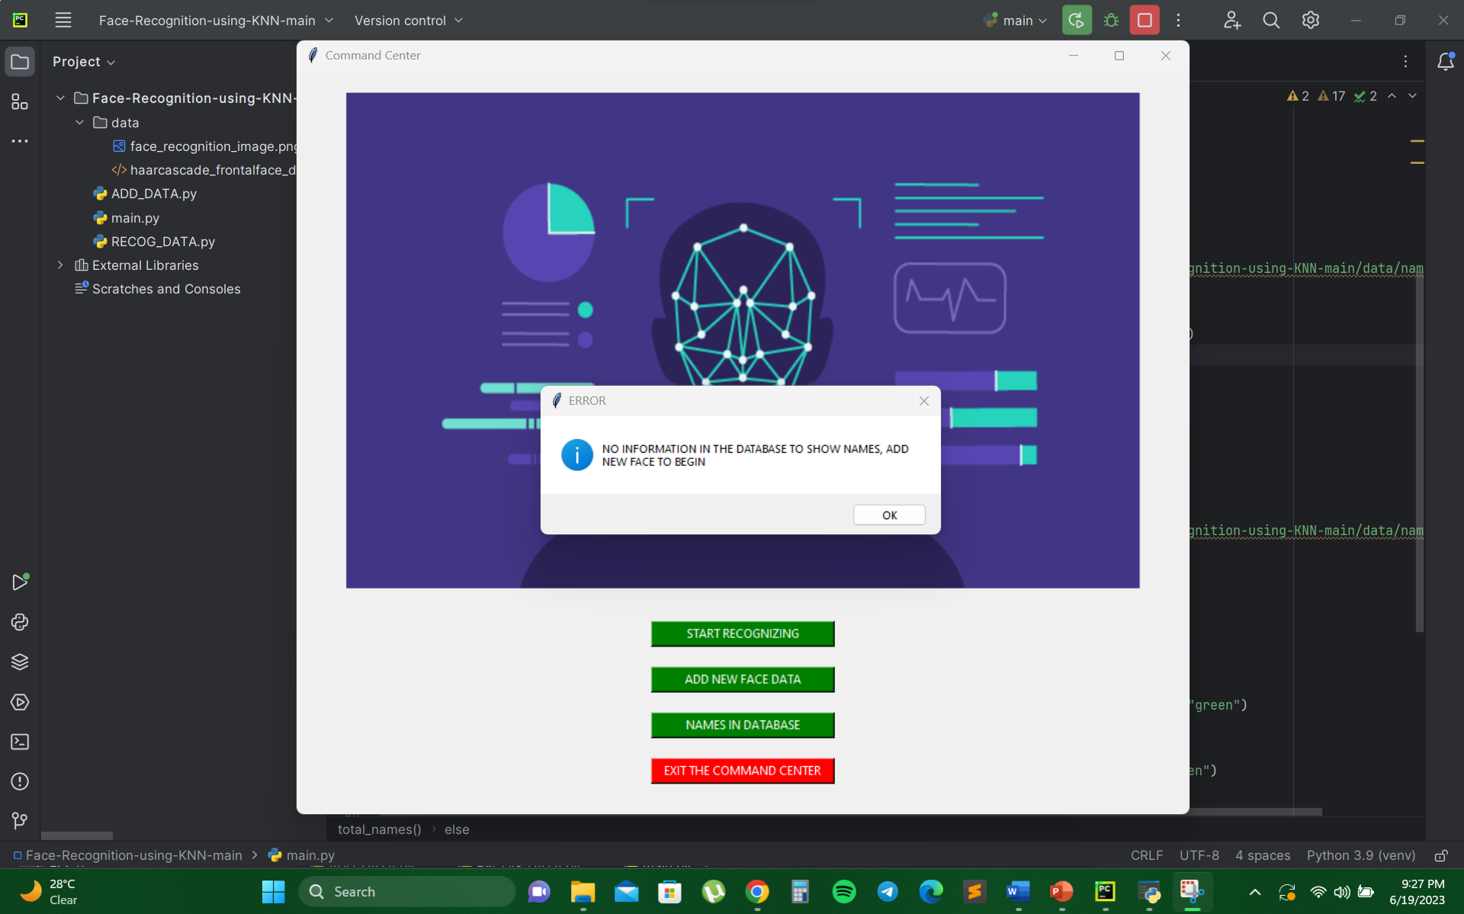
Results/Simulations
GUI &EXCEPTION HANDLING:

Slide 17
REFERENCES
1. Bledsoe, W. (1996). “Face Recognition and Identification”. Technical Report, Panoramic Research, Inc.
2. Belhumeur, P. N., Hespanha, J. P., & Kriegman, D. J. (1997). "Eigenfaces vs. Fisherfaces: Recognition using class specific linear projection." IEEE Transactions on Pattern Analysis and Machine Intelligence, 19(7), 711-720.
3. Face Recognition using OpenCV and Python: https://www.datacamp.com/community/tutorials/face-recognition-python-opencv
4. Hastie, T., Tibshirani, R., & Friedman, J. (2009). "The Elements of Statistical Learning: Data Mining, Inference, and Prediction." Springer.
5. Bishop, C. M. (2006). "Pattern Recognition and Machine Learning." Springer.
6. Haar Cascade Classifiers for Object Detection: https://opencv-python-tutroals.readthedocs.io/en/latest/py_tutorials/py_objdetect/py_face_detection/py_face_detection.html
7. Pattern Recognition and Machine Learning by Christopher M. Bishop
8. K-Nearest Neighbors Algorithm Explained: https://towardsdatascience.com/knn-algorithm-and-implementation-from-scratch-b9f9b739c02e
9. Hands-On Machine Learning with Scikit-Learn and TensorFlow by Aurélien Géron
10. scikit-learn: Machine Learning in Python: https://scikit-learn.org/

Slide 18
REFERENCES
11. Tkinter GUI Application Development Blueprints by Bhaskar Chaudhary
12. The official GitHub repository of PILLOW provides access to the source code, issue tracker, and examples that can help you understand how the library works. https://github.com/python-pillow/Pillowhttps://github.com/python-pillow/Pillow
13. "Hands-On Machine Learning with Scikit-Learn, Keras, and TensorFlow" by Aurélien Géron”
14. Deep Face Recognition" paper by Yaniv Taigman et al.: https://www.cs.toronto.edu/~ranzato/publications/taigman_cvpr14.pdf
15. FaceNet: A Unified Embedding for Face Recognition and Clustering" paper by Florian Schroff et al.: https://arxiv.org/abs/1503.03832

